Slide 1
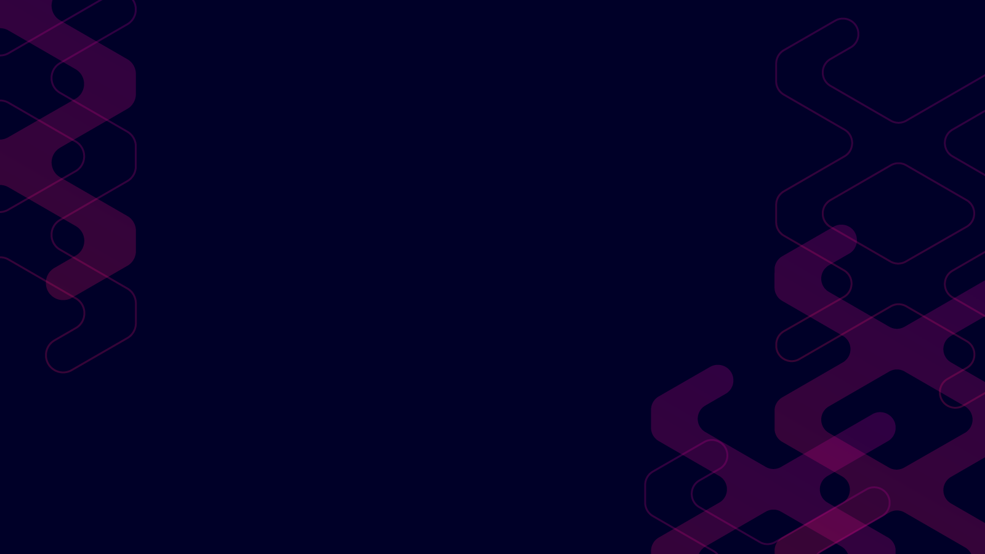

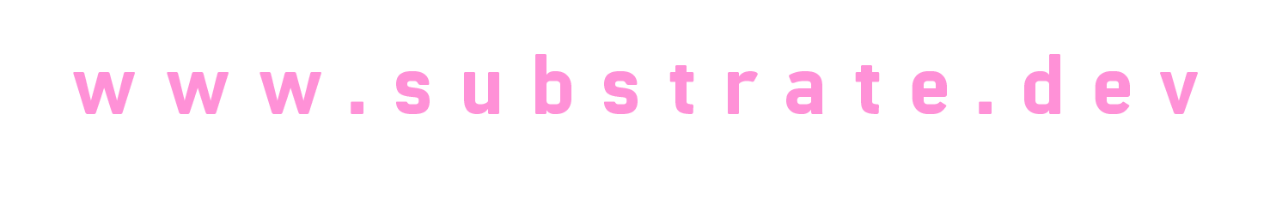
Join the network!
How to become a parachain.
Shawn Tabrizi Software developer @ Parity Technologies Ltd. shawntabrizi@parity.io | @shawntabrizi
Notes:
Use Roboto font
Dark blue colour: #000028
Green colour: #18ffb2
Pink colour: #FF1864

Slide 2
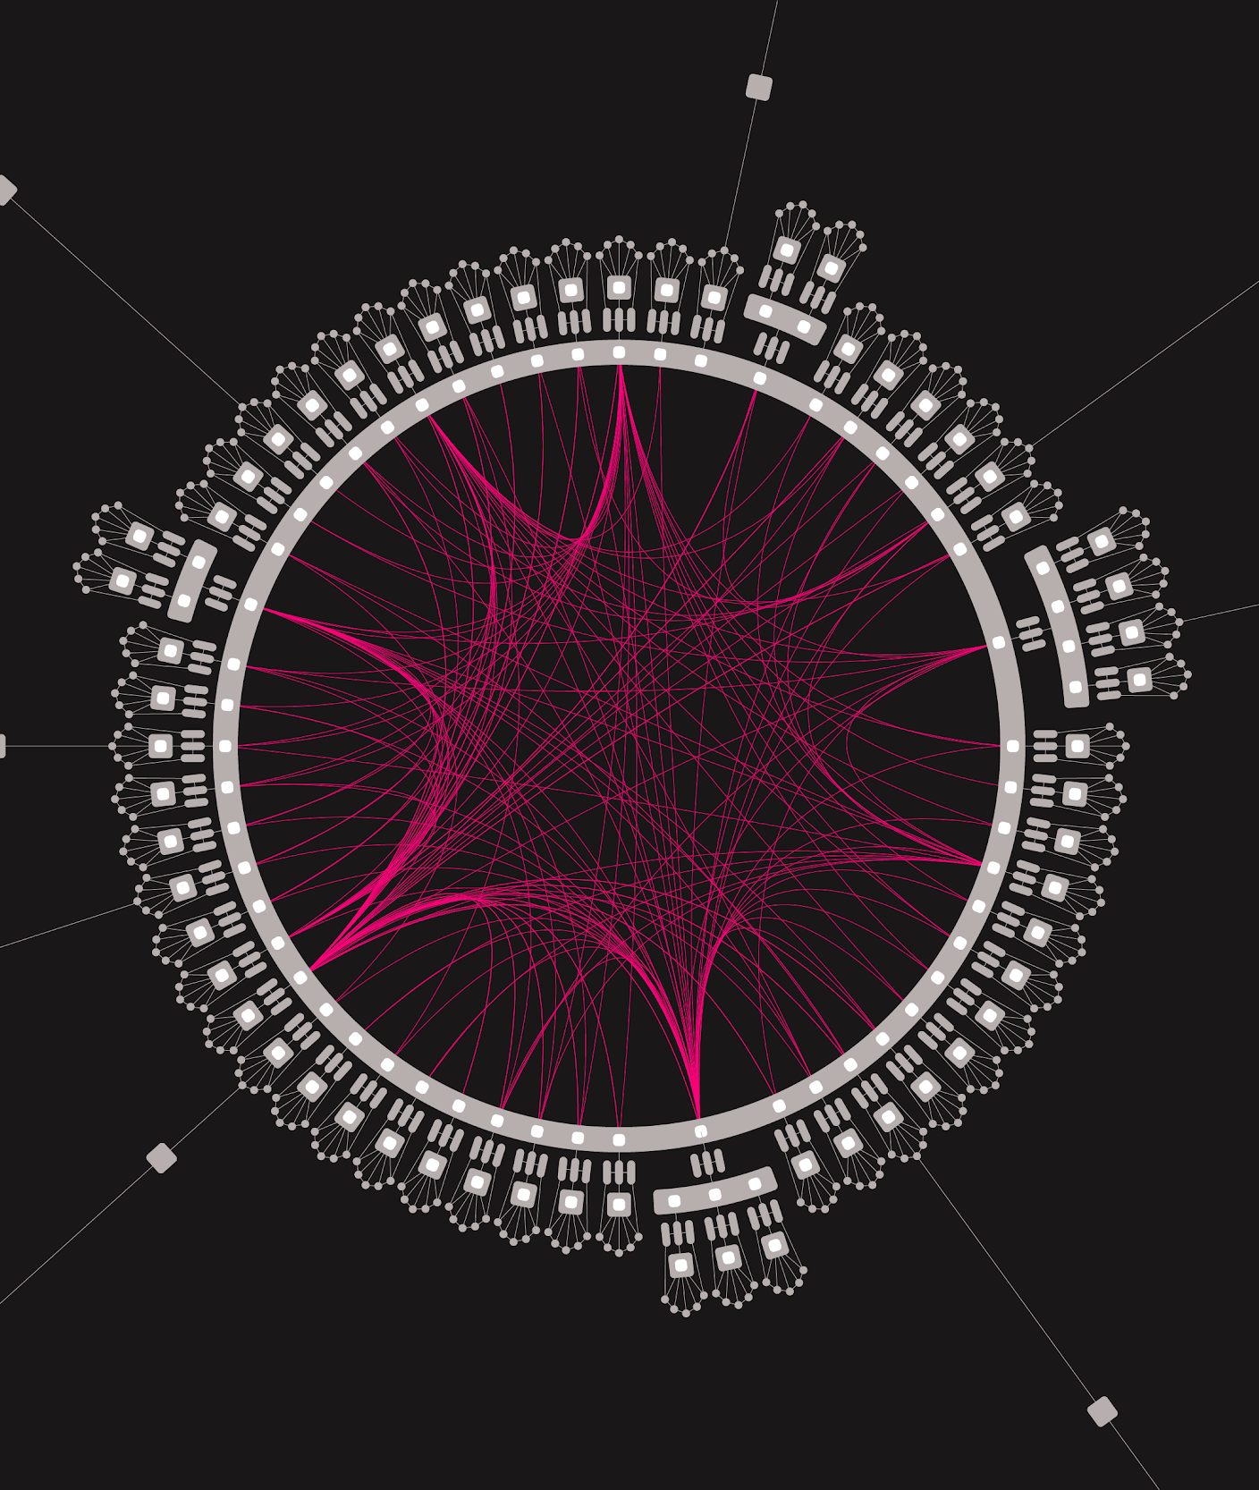
What is Polkadot?
Polkadot is a network that connects blockchains.
A vision toward a multi-chain future.
Notes:
But why is our vision of Web3 directed toward a multi-chain future?
First we should address the value of blockchains.
Blockchains can help solve trust problems.
Blockchains are public, distributed, decentralized, and individually verifiable.
And as a result, echo the saying of less trust, and more truth.
Why multiple of them? Well evidence has shown that a blockchain that can do everything
can’t quite do anything the best.
Individuals blockchains which are designed from the ground up to acomplish a particular task
Can help solve the scaling issues we have found with other modern networks.
Finally, connecting these specialized blockchains together
ultimately help add real world value to the larger network.
With each blockchain relying on the others to provide the servies they were built for

Slide 3
What is Polkadot?
Polkadot attempts to solve three problems:
Interoperability
Scalability
Shared Security.
Notes:
But why is our vision of Web3 directed toward a multi-chain future?
First we should address the value of blockchains.
Blockchains can help solve trust problems.
Blockchains are public, distributed, decentralized, and individually verifiable.
And as a result, echo the saying of less trust, and more truth.
Why multiple of them? Well evidence has shown that a blockchain that can do everything
can’t quite do anything the best.
Individuals blockchains which are designed from the ground up to acomplish a particular task
Can help solve the scaling issues we have found with other modern networks.
Finally, connecting these specialized blockchains together
ultimately help add real world value to the larger network.
With each blockchain relying on the others to provide the servies they were built for

Slide 4
Why a multi-chain future?
Blockchains can help solve trust problems.
Specialization can help solve scalability issues.
Interoperability can help add real world value.
Notes:
But why is our vision of Web3 directed toward a multi-chain future?
First we should address the value of blockchains.
Blockchains can help solve trust problems.
Blockchains are public, distributed, decentralized, and individually verifiable.
And as a result, echo the saying of less trust, and more truth.
Why multiple of them? Well evidence has shown that a blockchain that can do everything
can’t quite do anything the best.
Individuals blockchains which are designed from the ground up to acomplish a particular task
Can help solve the scaling issues we have found with other modern networks.
Finally, connecting these specialized blockchains together
ultimately help add real world value to the larger network.
With each blockchain relying on the others to provide the servies they were built for

Slide 5
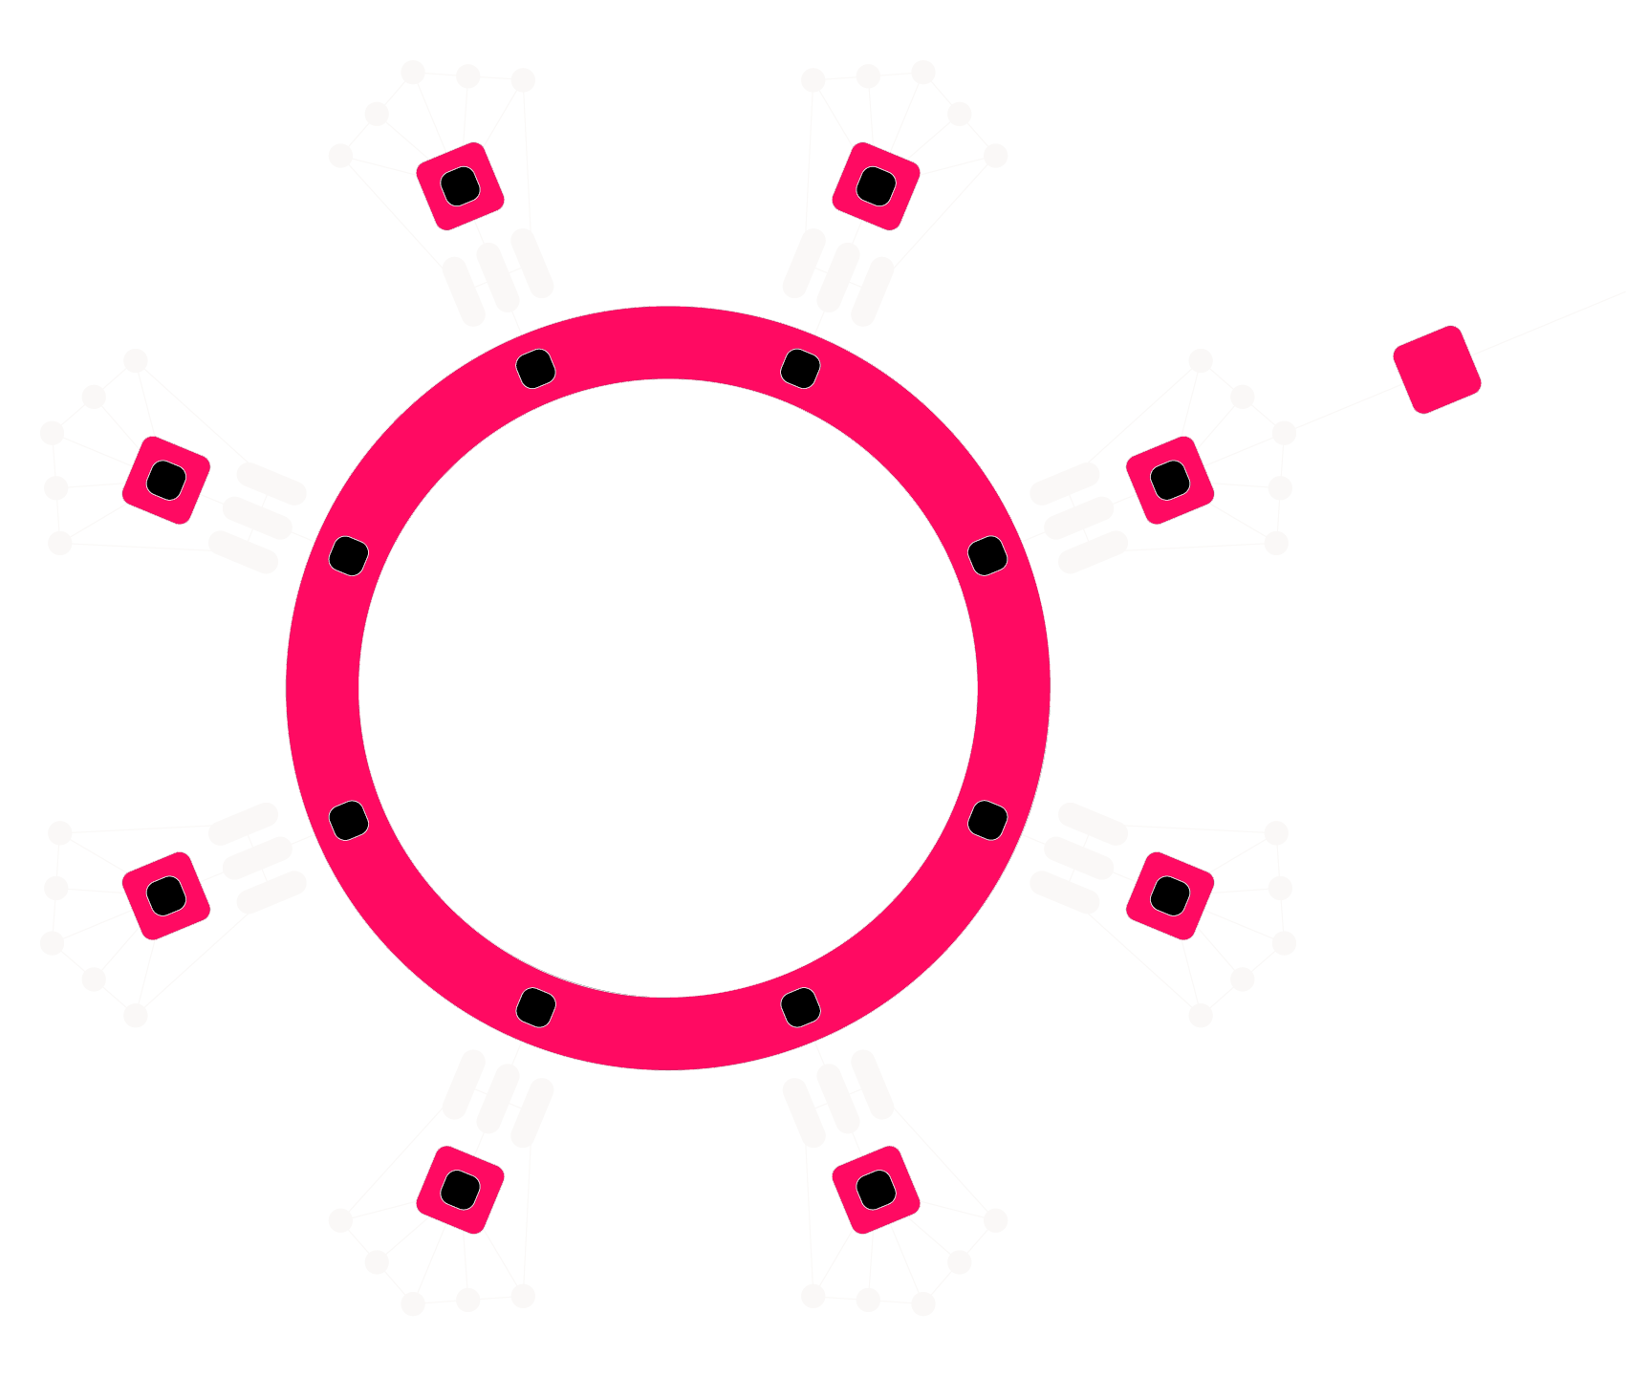
Collators
Parachain
Validators
Relay Chain
Components of Polkadot
Notes:
And here is ultimately what that vision looks like in the context of the Polkadot Network.
You see around the edges different blockchains, which we call Parachains.
They are all connected and able to interact with one another through a relay chain.
And so you may be asking, how does Substrate come into play with this vision?

Slide 6
WHAT DOES IT MEAN?

Slide 7
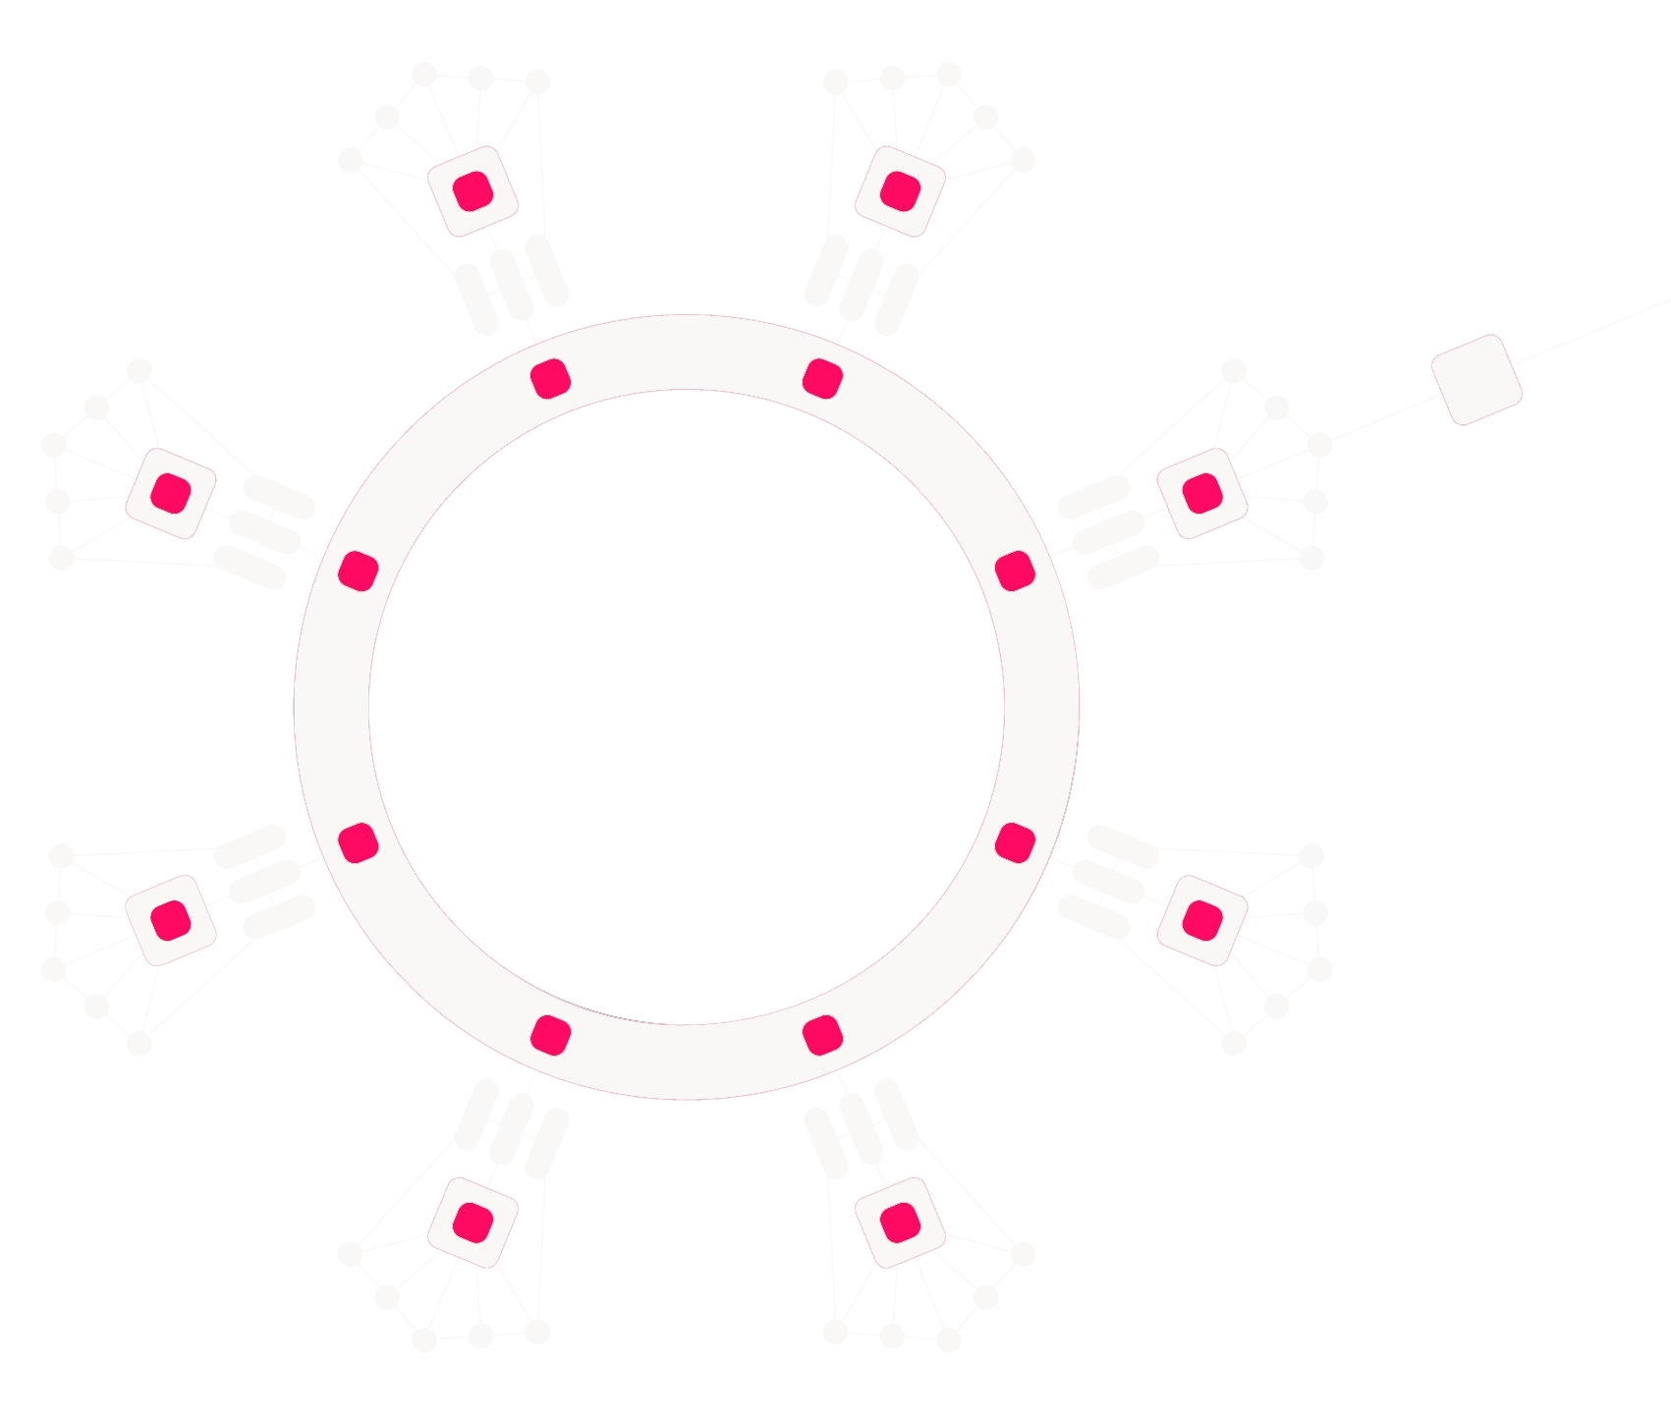
What Does It Mean?
As a parachain…
You get the opportunity to put your blockchain’s latest block head onto the relay chain.

Slide 8
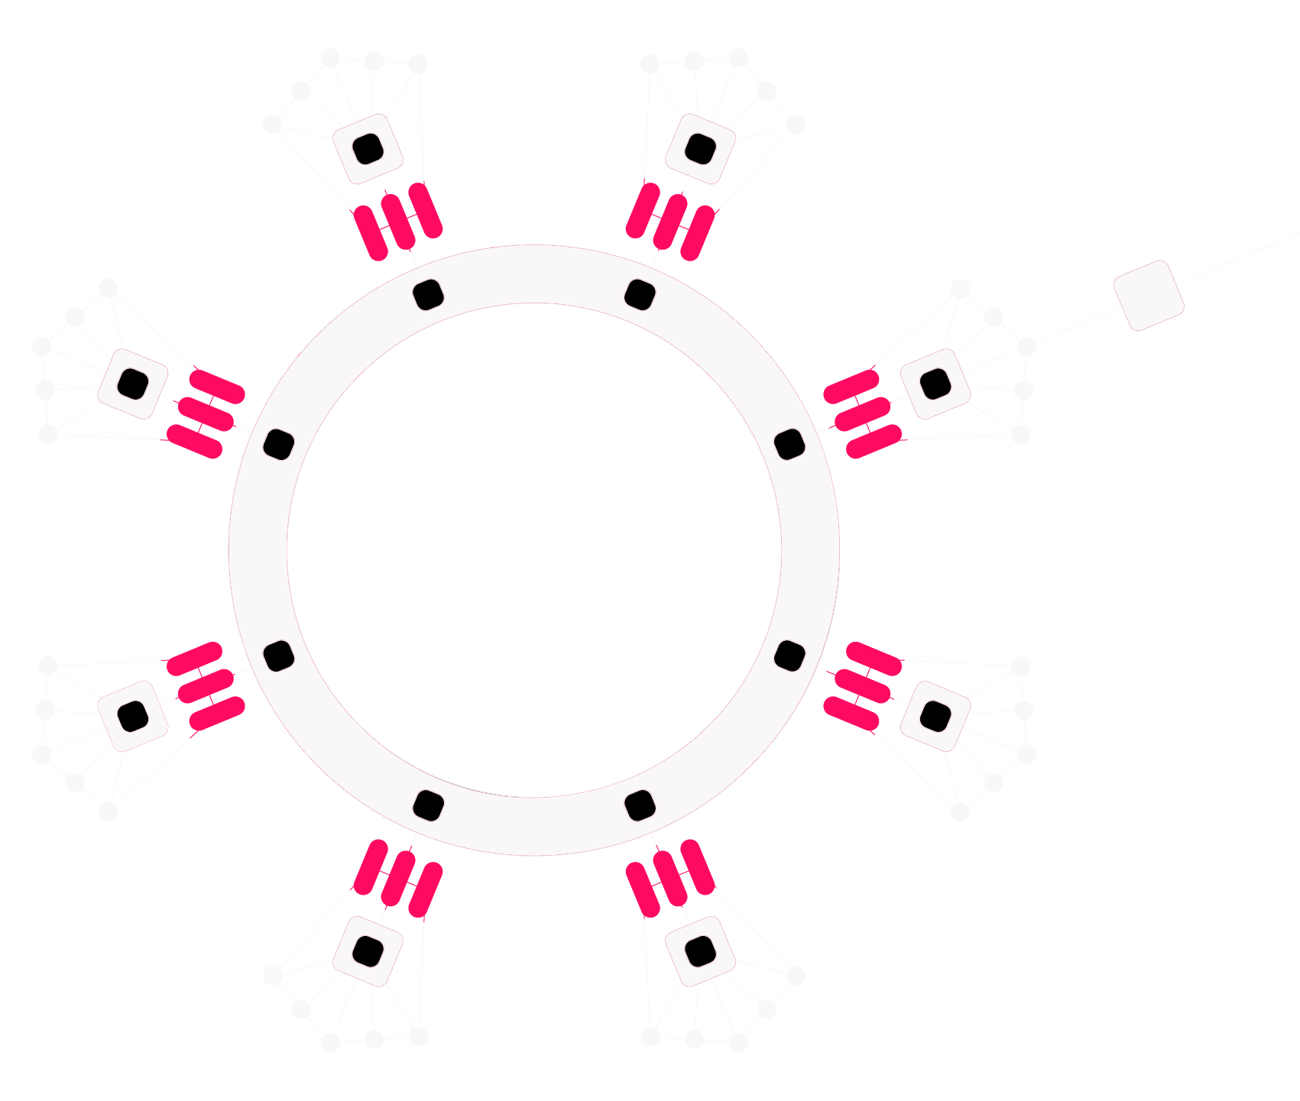
What Does It Mean?
As a parachain…
The blocks you submit are verified by validators with a Wasm runtime you are able to store on the relay chain.

Slide 9

What Does It Mean?
As a parachain…
You get the ability to communicate with other parachains using an abstract message passing system.

Slide 10
Deeper Meaning
Because you can place your blockchain’s head onto the relay chain…
You can achieve deterministic finalization for your chain.

Slide 11
Deeper Meaning
Because the validators have the Wasm runtime of all the parachains…
You share the security of the validator pool with everyone on the relay chain.

Slide 12
Deeper Meaning
Because message passing is tracked on the relay chain…
You can prove the delivery of messages and facilitate trustless interactions.

Slide 13
Great!
So everyone should be a parachain…?

Slide 14
Scarcity in Resources
Polkadot has O(n²) complexity where n is the number of parachains.
Networking, message passing, block size, etc… all limit what a single relay chain can do.

Slide 15
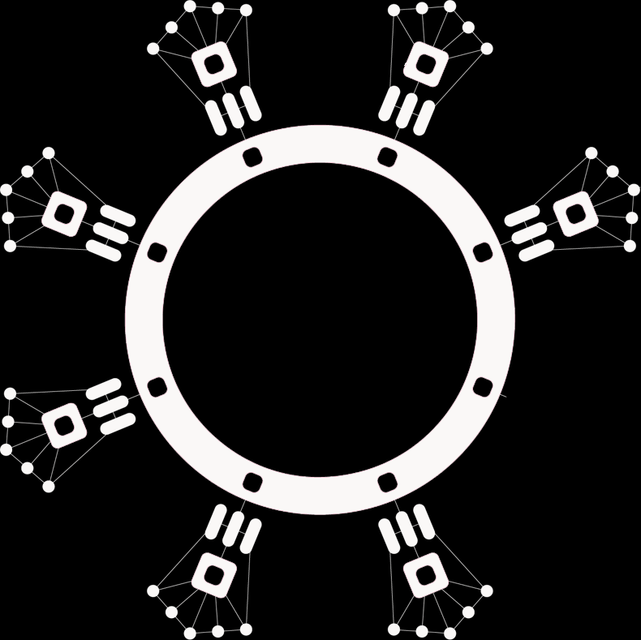
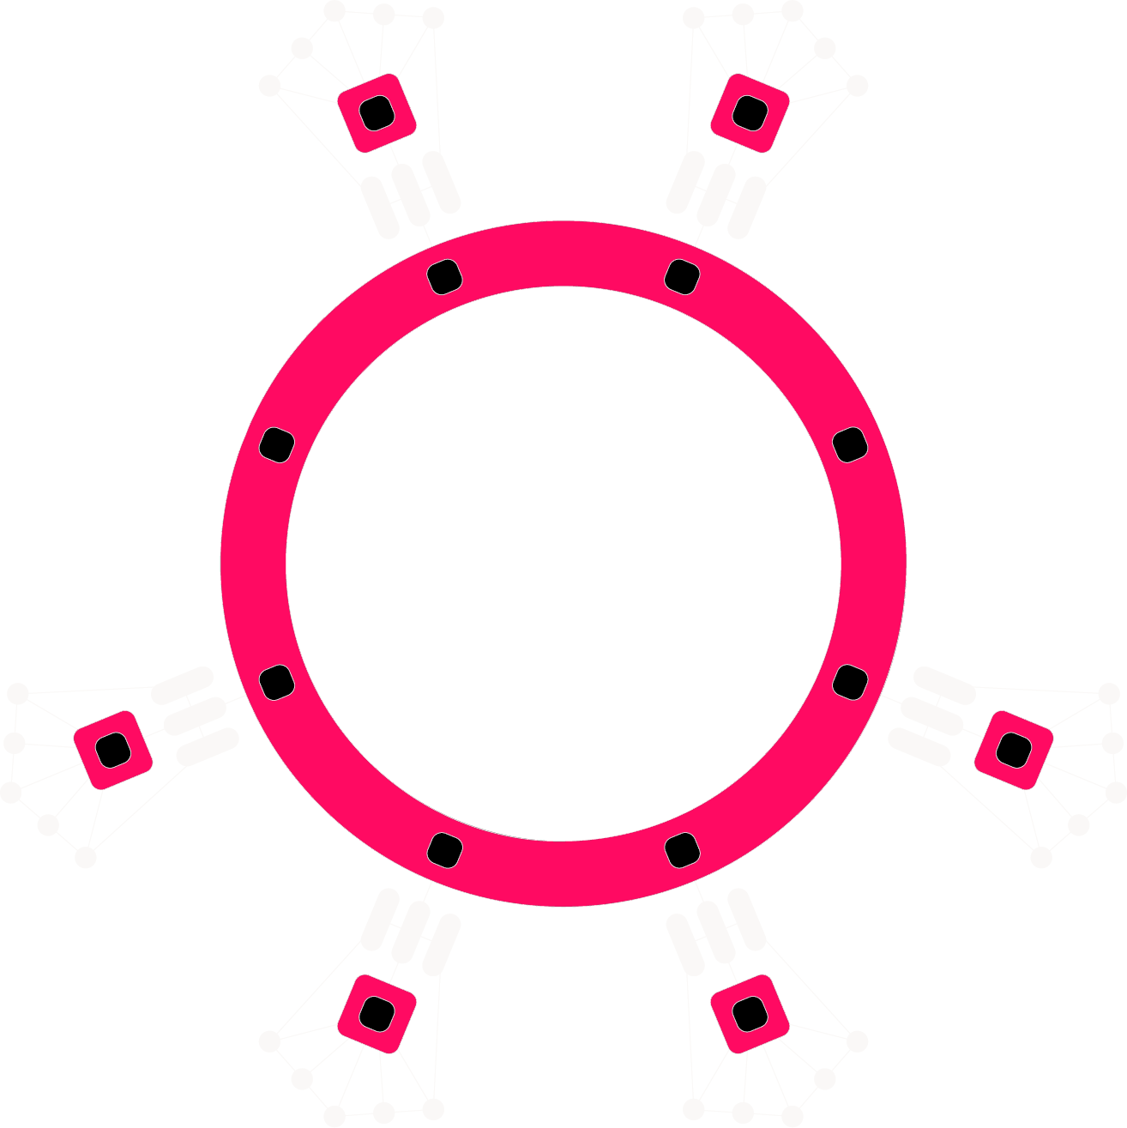
A Bright Future
DeFi
Relay Chain
Gaming
Relay Chain
Relay Chain

Slide 16
Relay Chain Volume
Optimistically, the Polkadot relay chain may support up to 100 parachains for each block.
Bridge Hubs | Nested Relays | System | Leased Slots | Parathread Pool
10 - 30 System Level
Permanent Chains
40 - 90
Lease Slots
Up to 50 parathreads executing per block

Slide 17
Parachain vs Parathread
Same:
Developer API
You do not need to develop your blockchain any differently to be a parachain or a parathread.
In fact you can freely “swap” between the two!
Different:
Acquisition Process
Scheduling / Throughput
Parachain: Full Throughput
Parathread: Pay-As-You-Go
Economics
Parachain: Long term investment
Parathread: Non-refundable fees

Slide 18
So let’s talk about “the how”...

Slide 19
Relevant Polkadot Modules
Polkadot is just a Substrate chain.
Registrar
Parachains
Slots
Crowdfund

Slide 20
Relevant Polkadot Modules
Registrar Module:
Manages Registration.
Holds all “ParaIds”.
Tracks active paras.
Parathread auctions.
Registrar
Parachains
Slots
Crowdfund

Slide 21
Relevant Polkadot Modules
Parachains Module:
Actual execution and validation logic.
Message passing.
Stores latest para-head and runtime code.
Registrar
Parachains
Slots
Crowdfund

Slide 22
Relevant Polkadot Modules
Slots Module:
Executes parachain auctions.
Manages parachain slots.
Manages reserved funds.
Registrar
Parachains
Slots
Crowdfund

Slide 23
Relevant Polkadot Modules
Crowdfund Module:
Allow the community to fund your Parachain auction.
Tracks community contributions.
Registrar
Parachains
Slots
Crowdfund

Slide 24
Para-Auctions

Slide 25

Parachain Auction
Uses a candle auction.
Initiated by governance
Auctions happen one at a time.
Auctions a 2 year “slot”
Split into 4 parts (6 month periods)
All DOTs returned at end of lease!

Slide 26
Candle Auction
Retroactive ending block determined using VRF.
Opening Period | Ending Period
Encourages healthy price discovery; discourages “sniping”.
Helps mitigate the effects of malicious block producers.
Does not require a “commit and reveal” scheme.

Slide 27
Mechanics of a Parachain Auction
Bidders | Lease Periods | Bid | Locked Value | Total
 |  | 200 | 800 | 800 winner
 |  | 200 | 200 | 500
 |  | 100 | 300
 |  | 300 | 600 | 700
 |  | 50 | 100
Alice
Q1
Q2
Q3
Q4
Bob
Q1
Charlie
Q2
Q3
Q4
Dave
Q1
Q2
Emily
Q3
Q4

Slide 28
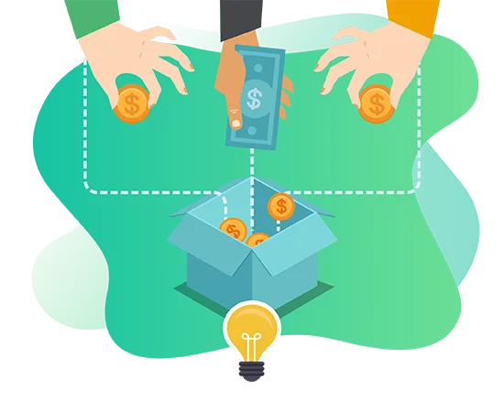
Crowdfund Your Parachain
Allow the community to back your parachain.
Reward those users with your native token.
Crowdfund automatically handles the auction process.

Slide 29
Mechanics of a Crowdfund
Cap
An initial deposit must be made.
Anyone can contribute, but must be at least min contribution.
New contributions trigger a bid.
Crowdfund ends at a set “end date”.
Crowdfund can span multiple auctions.
Raised
Deposit

Slide 30
Mechanics of a Crowdfund
Substrate Storage
Child trie tracks user contributions.
Success :) or Failure :(
Eventually you retire…
Retirement period for people to recollect their funds.
Child Trie
contributions

Slide 31
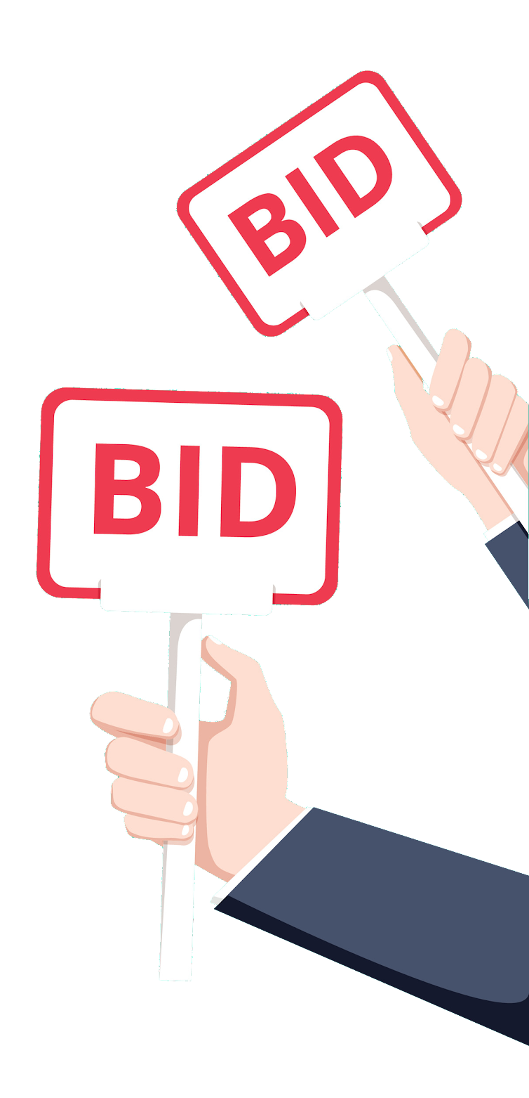
Parathread Auction
Uses an English auction.
Parathreads need to lock a nominal deposit which can be refunded.
Happens every block.
Number of winners based on thread count.
DOTs used for bidding are consumed.

Slide 32
Mechanics of a Parathread Auction
select_parathread(...)
Alice
+12 TIP
TX Pool
Order | User
1 | Alice
2 | Emily
3 | Charlie
4 | Bob
5 | Dave
Registrar
Winners
Alice
Emily
Charlie
Bob
Signed Extension
Logic
+5 TIP
Charlie
Relay Chain
Dave
+9 TIP
3 parathread slot cut-off
Emily

Slide 33
Winning a Parathread Auction
If you win a slot, you will be queued to submit new heads on the next block.
If you miss your slot, you get 3 additional retries on the following blocks.
Submit your new head.
Make a bid.
BLOCK
41
BLOCK
42
BLOCK
43
BLOCK
44
BLOCK
45
BLOCK
46
You won!

Slide 34
Aside: Signed Extensions
/// Place a bid for a parathread to be progressed in the next block.
fn select_parathread(origin,
#[compact] _id: ParaId,
_collator: CollatorId,
_head_hash: T::Hash,
) {
ensure_signed(origin)?;
// Everything else is checked for in the
// transaction `SignedExtension`.
}
Notes:
This is a kind of special transaction that should by heavily prioritized in the transaction pool according to the `value`; only `ThreadCount` of them may be presented in any single block.

Slide 35
Aside: Signed Extensions
A way for all transactions to be extended.
Validation function allows for transaction queue to quickly eliminate transactions.
Extrinsic Format
Address | Signature | Extra | Call
Extra data is not always needed to use this feature!

Slide 36
Aside: Signed Extensions
You can:
Verify “implied” information in the signature.
Increase/decrease priority in the transaction queue.
Trigger additional logic for certain function calls within your runtime.
Used for:
Checking Replay Attacks
Fees (Transaction Payment)
Checking Weight Limit
Gas Limit (Contracts)
Parathread Auctions
Limit Chain Functionality
and more...

Slide 37
Para-Economics

Slide 38


Parachain Economics
Locking your DOTs “isn’t free”.
There is an opportunity cost.
Ideally you increase the value of the network by participating, and this is a good return of investment with your DOTs.
when moon?

Slide 39
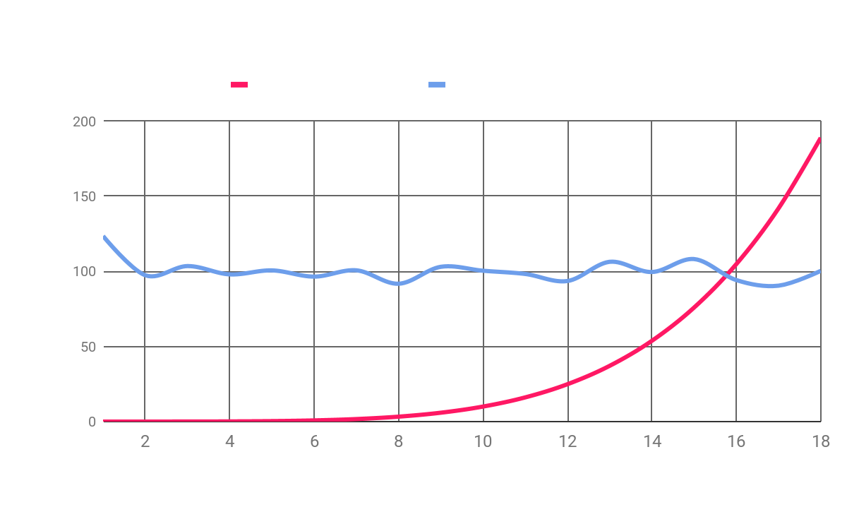
Parathread Economics
Incentivize collators with native token payout.
Transaction Fees Collected
Parathread Token Sponsorship
Blocks naturally produced when parathread bid is less than native token payout.

Slide 40
Para-Lifecycle
Downgrade to a parathread to sell your slot or when your slot ends.
Parathread
Full security.
Instant connectivity.
Partial volume (pay-as-you-go).
Parachain
Full security.
Instant connectivity.
Full throughput.
Upgrade to a parachain for maximum throughput.

Slide 41

Cumulus: Write Parachains on Substrate
A library which allows you to easily convert your Substrate codebase into a compatible Polkadot Parachain.
Cumulus Consensus
Cumulus Runtime
Cumulus Collator
In progress...

Slide 42
Questions?
shawntabrizi@parity.io @shawntabrizi

